Slide 1


Sustainability
at Kids Count

Slide 2


The Department for Education's (DfE) sustainability leadership and climate action plans initiative
Overview
The sustainability and climate change strategy for education states: “By 2025, all education settings will have nominated a sustainability lead and put in place a climate action plan”. This includes early years settings, schools, multi-academy trusts, colleges, and universities.
Wherever you are on your sustainability journey, this non-statutory guidance and the support now available can help you get started or take the next step.
Support is available to nurseries, schools and colleges and is provided by DfE through:
Sustainability Support for Education: provides resources, services and tools to help you identify appropriate action to develop, or build on, your climate action plan
Climate Ambassador Programme: provides access to on-the-ground volunteer climate ambassadors and regional networks to support the development and delivery of impactful climate action plans, working in partnership with Let’s Go Zero Climate Action Advisors
The National Education Nature Park: provides curriculum-linked resources and practical activities to engage children and young people in nature and the improvement of their local environment. Participation in the Nature Park is a great way to add meaningful education, skills and biodiversity action to your plan
There are many organisations providing courses, products, and services to support an education setting’s approach to climate change. There are also many examples of excellent practice when it comes to sustainability and climate change in the education sector, and your individual setting or trust may already have a plan in place. Where this is the case we are not suggesting that you create a new plan.

Slide 3

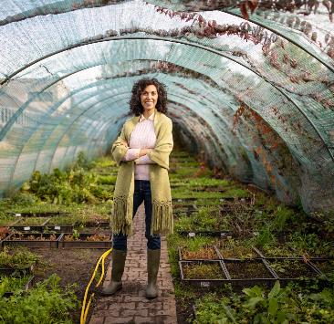
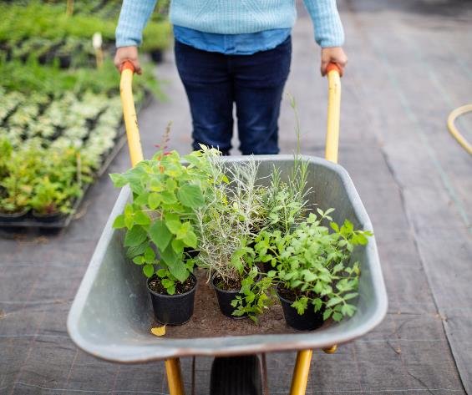
Why having a sustainability leadership and a climate action plan is important?
Ensuring you have clear leadership for sustainability in place, and a climate action plan, will help your setting to:
increase the confidence and expertise of your leadership team, staff, learners, and students in understanding climate change and how positive change can be achieved
create a culture that prioritises sustainability
share effective practice with other education settings and develop a peer-to-peer learning network
use data to identify and prioritise action
improve energy and water efficiency
calculate your carbon emissions and identify ways to reduce them
reduce operating costs
increase resilience and start adapting to the impacts of climate change
enhance biodiversity
help learners develop skills and knowledge which help them to contribute to sustainability and climate change in their lives and future jobs

Slide 4
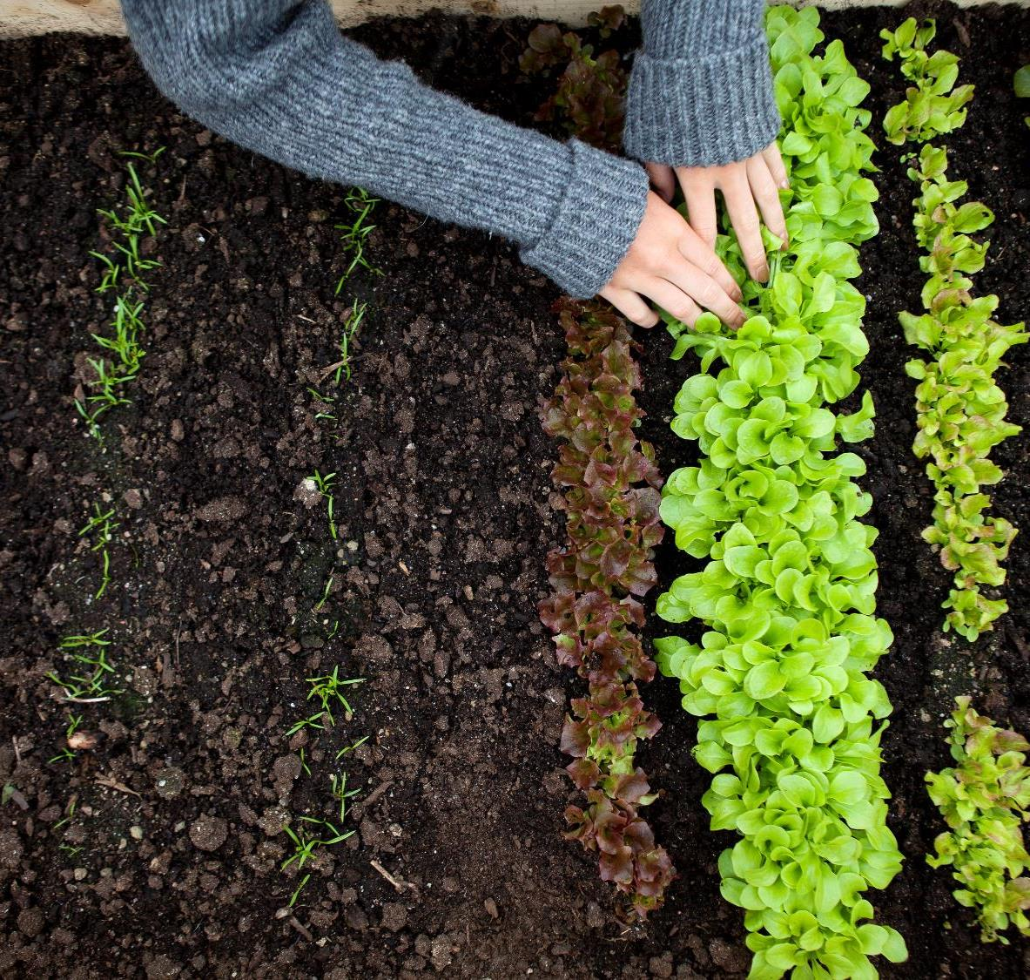
Developing and storing your climate action plans
A climate action plan is a detailed plan to enable your education setting, or trust, to progress or commence sustainability initiatives.
Creating a climate action plan will allow you to take a structured and strategic route toward ensuring your setting or trust is acting toward, and educating about, sustainability. You may choose to have a climate action plan that sits within an individual setting, across a trust, or both.
A holistic climate action plan should cover the following 4 areas:
Decarbonisation, for example calculating and taking actions to reduce carbon emissions, such as becoming more energy efficient
Adaptation and resilience, such as taking actions to reduce the risk of flooding and overheating
Improving the environment and biodiversity, for example engaging with the National Education Nature Park
Climate education and green careers, such as ensuring the education you provide gives knowledge-rich and comprehensive teaching about climate change, and that your teaching staff and lecturers feel supported to offer this

Slide 5

A whole-setting approach
It is important that the whole education setting, or trust, is engaged so that planning becomes action.
Learners
Involving children, young people and learners is important in climate action planning.
Doing so can: inspire their enthusiasm to help drive positive change increase their practical knowledge of sustainability and climate change give young people a sense of agency where anxiety stems from climate concerns create a sense of pride in their education setting enable them to share their knowledge and enthusiasm in their local communities enable them to engage their parents, carers, and wider community in sustainability and climate change

Slide 6



How can we work towards being sustainable?
Idea’s?

Slide 7

The way to get started is to quit talking and begin doing.
Walt Disney

Slide 8

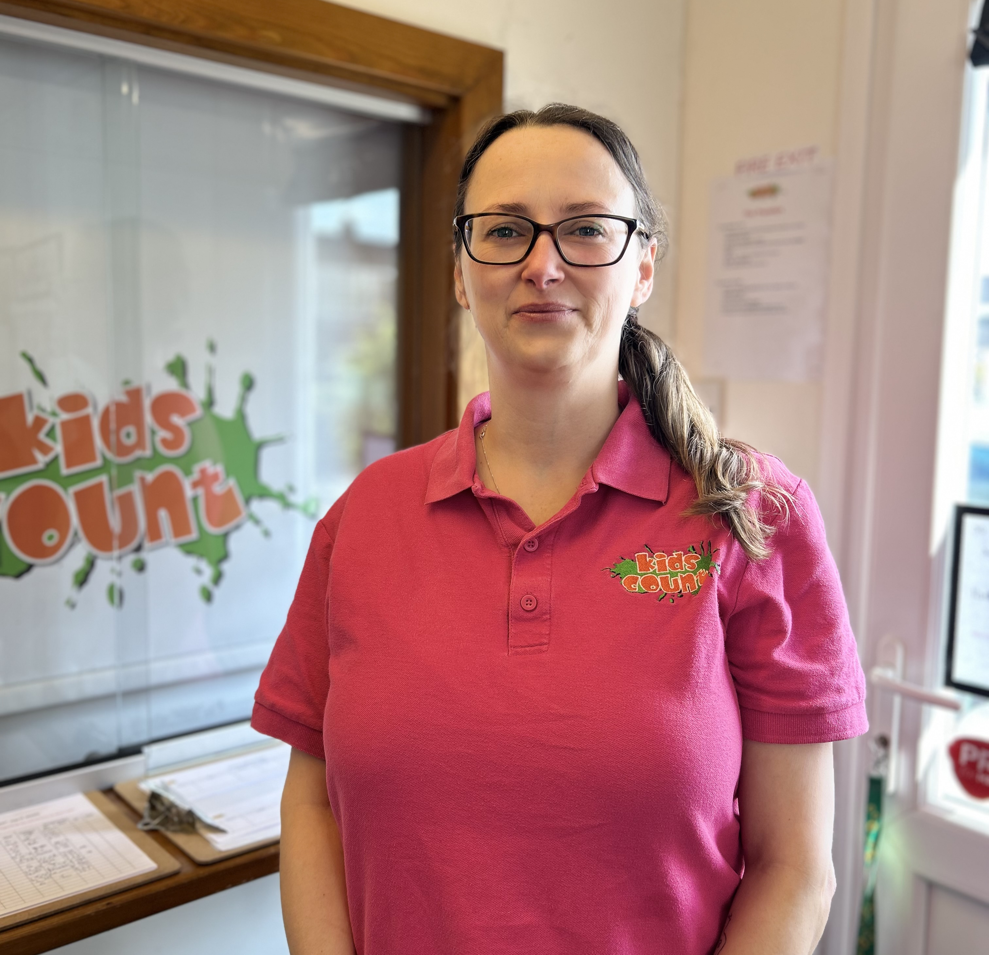
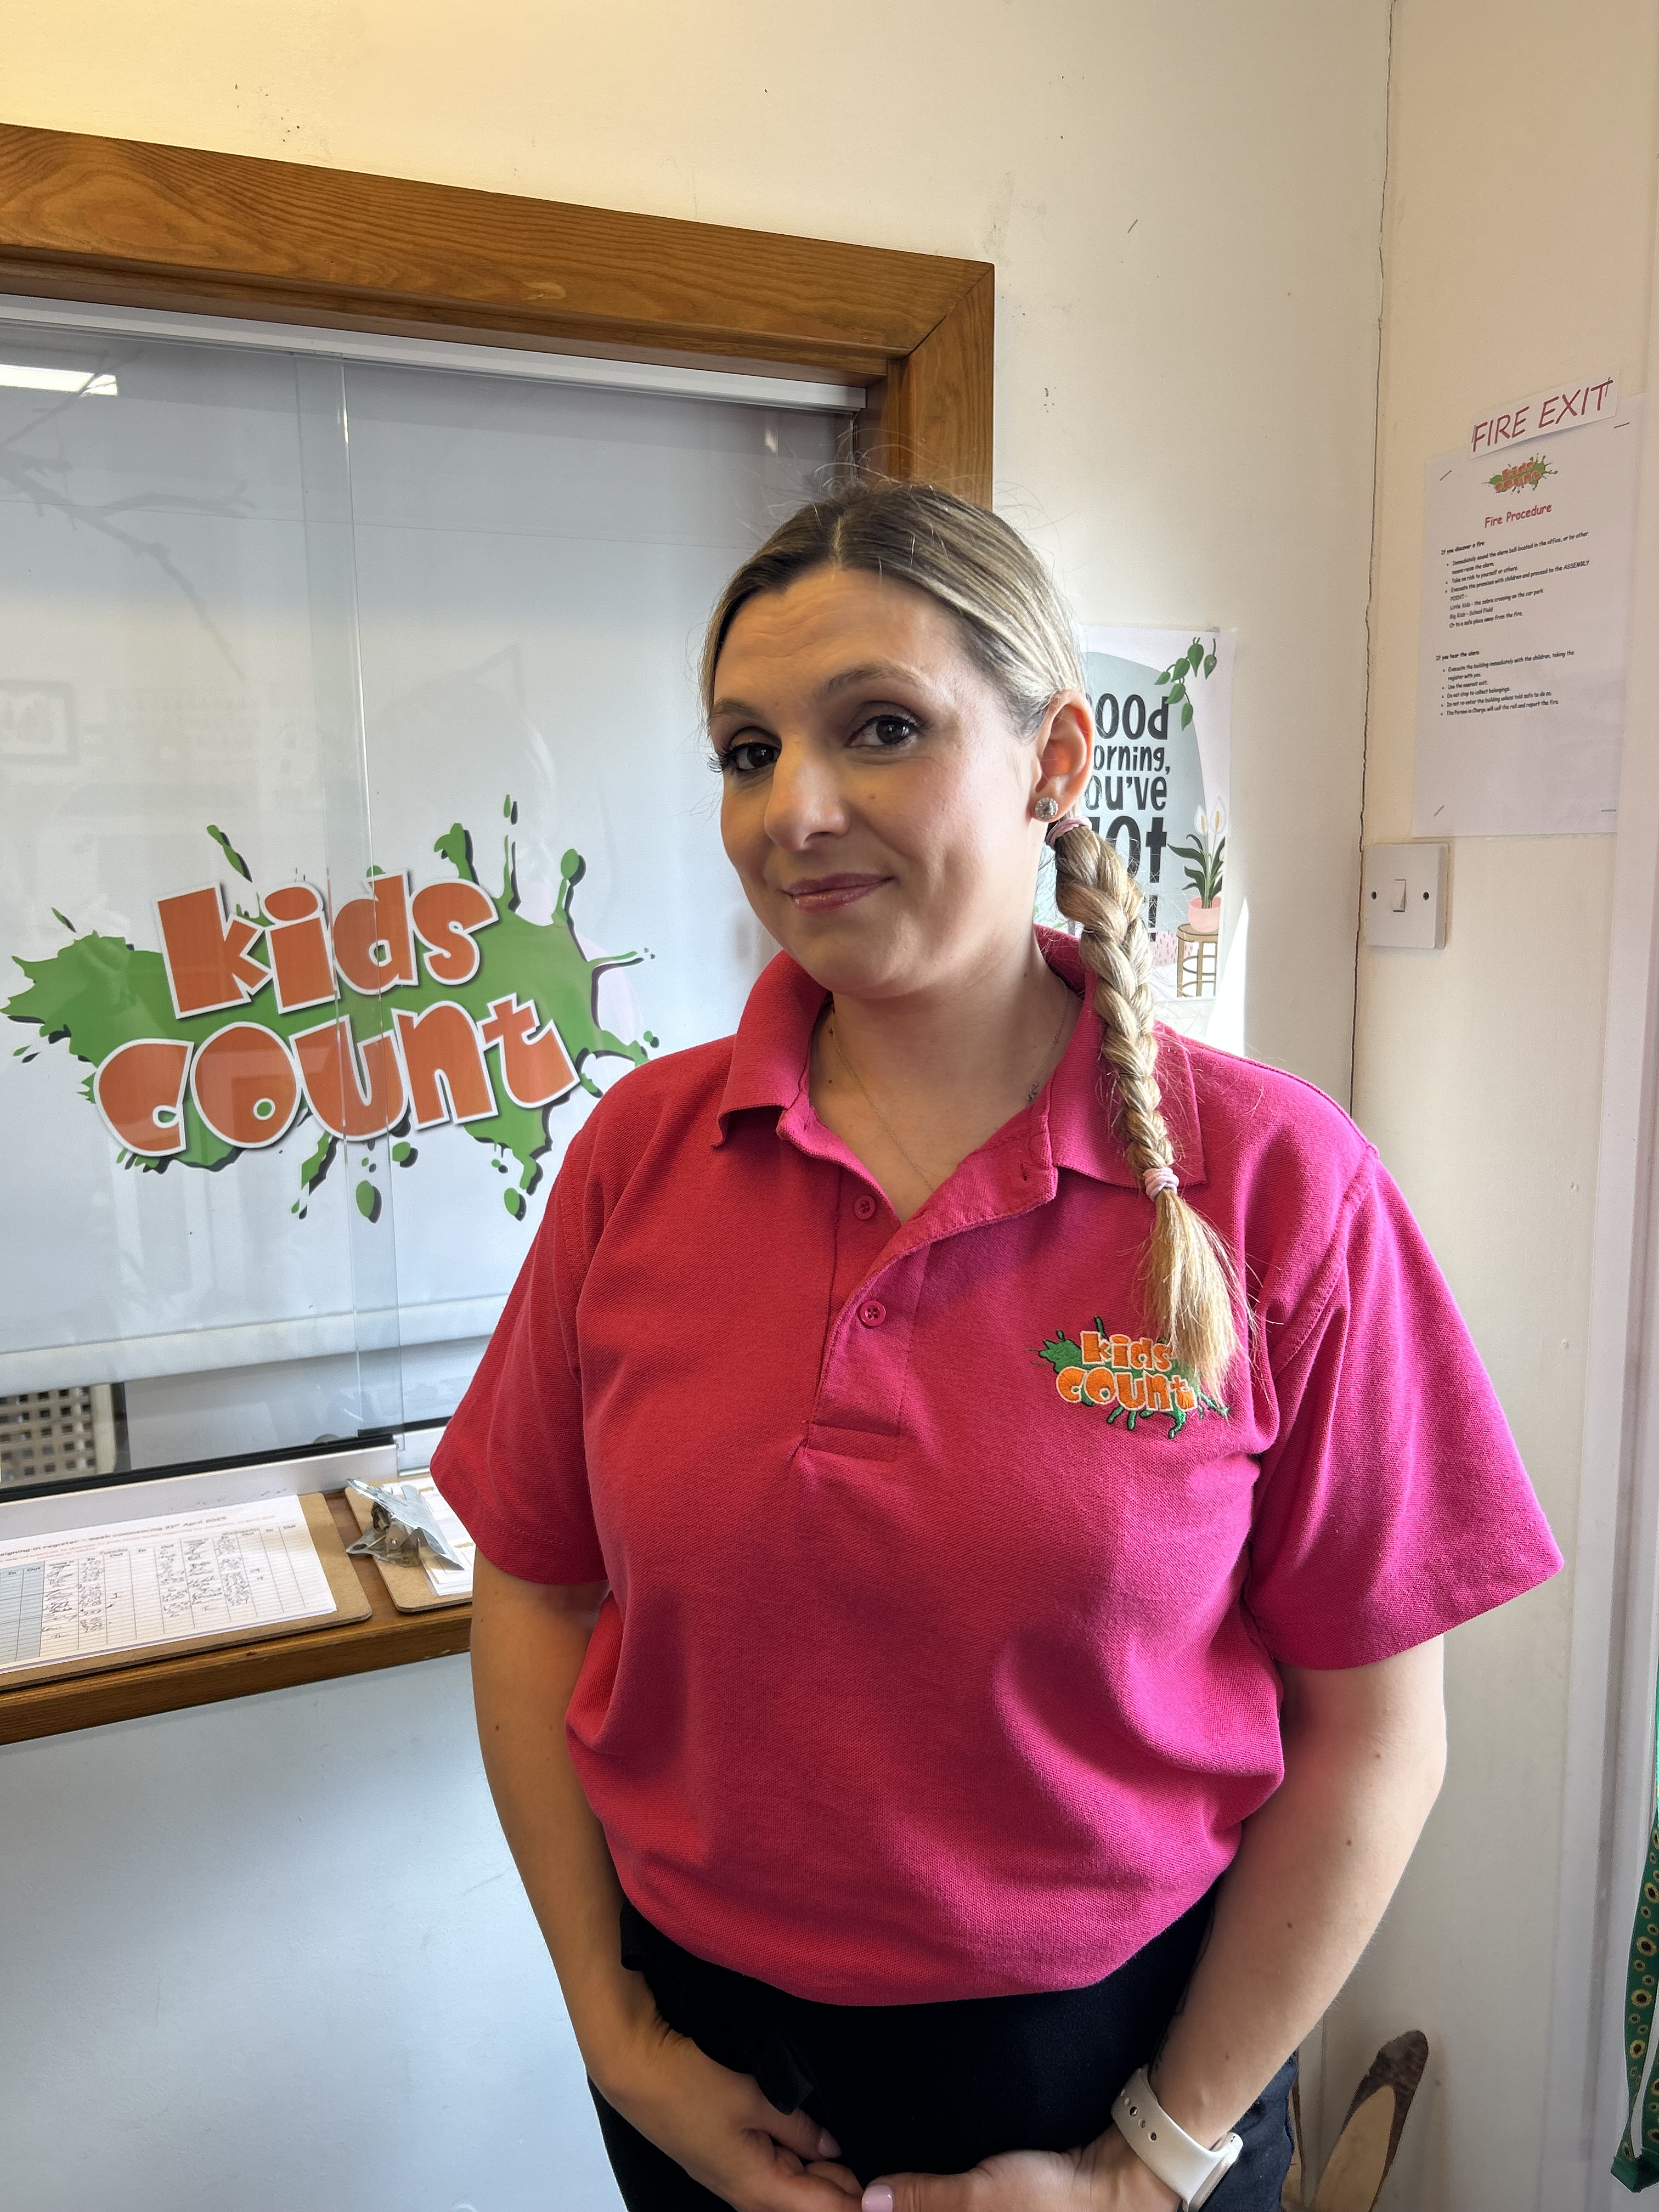
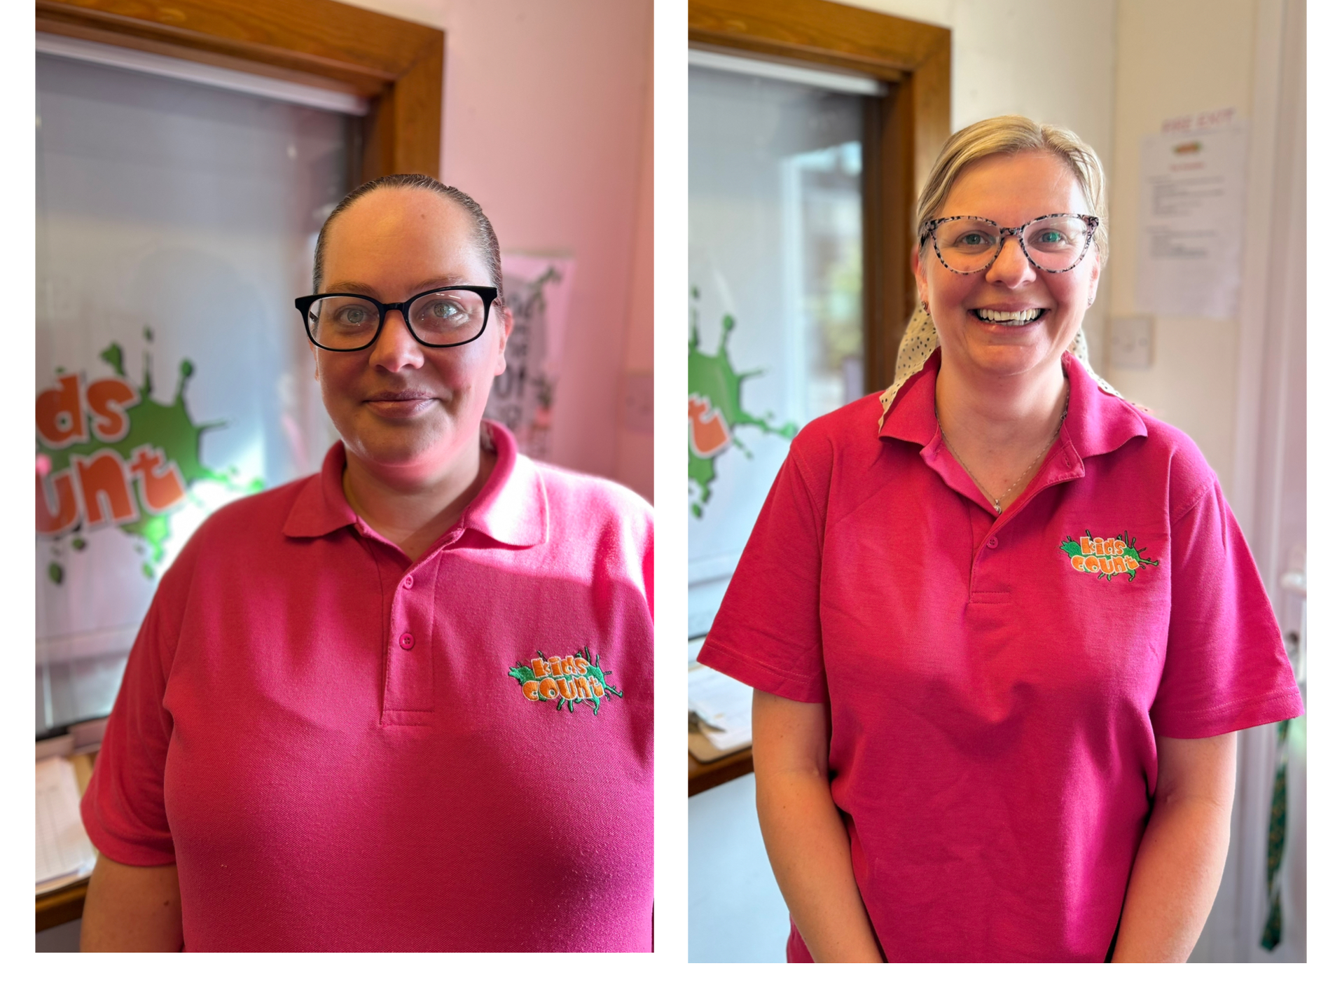
The Green Team!
Jennie
Amy
Nat
Rach and Becca
Green ambassador
Green ambassador
Sustainability Lead
Green ambassadors

Slide 9

Timeline
Whole setting approach
Title
Regular meetings with the green team to keep update date with sustainability and carbon footprint.
Aduit on current carbon footprint.
Discuss action plan with team at staff meetings.
Whole setting meeting to discuss sustainability and ideas on how we can try to be sustainable.
Create a climate action plan with timescales.

